Slide 1
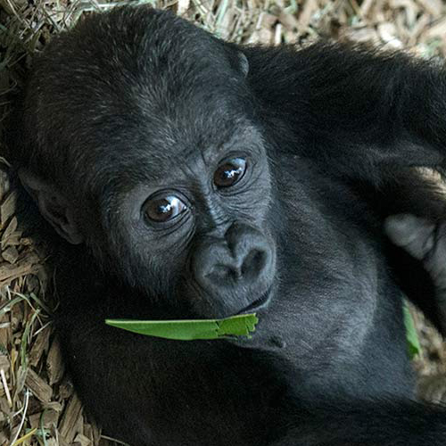

METADATA WORKING GROUP

Slide 2
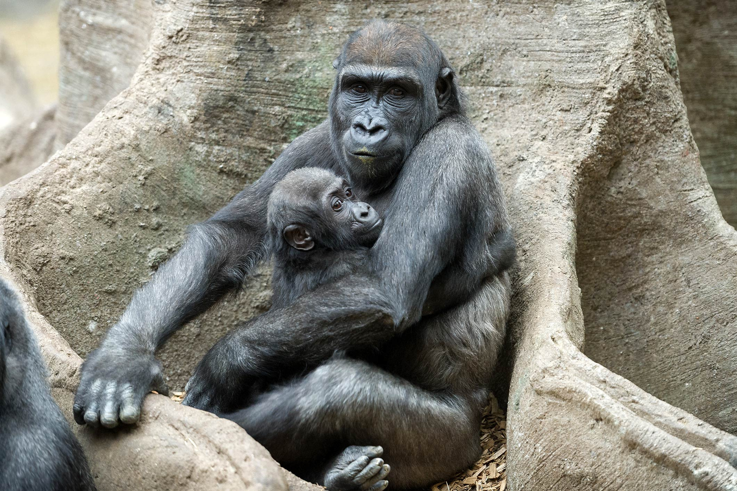

MEETING AGENDA
APRIL 29TH, 2025
Center for Zoonomics Overview
Group Introductions
Working Group Overview
Open Discussion
Next Steps and Future Meetings

Slide 3

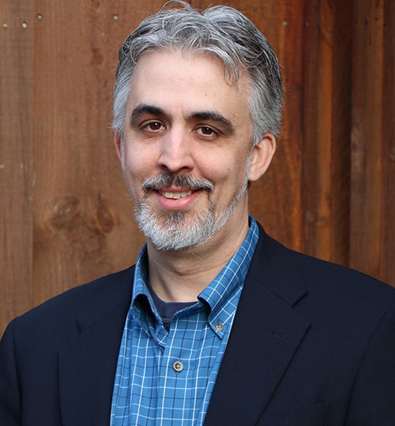
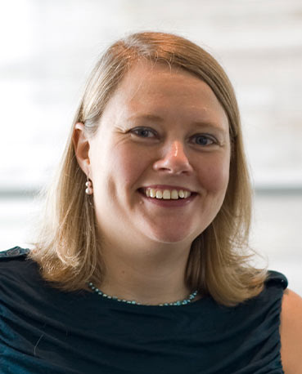
HOW DID THE CENTER FOR ZOONOMICS COME TO EXIST?
Collaboration with Broad Institute of MIT & Harvard
Dr. Eric Baitchman (Zoo New England) and Dr. Elinor Karlsson (Broad Institute) began investigating potential genetic causes of heart disease in both meerkats and gorillas managed in human care.
Recognized a Need for United Endeavor
Identified several barriers blocking efficient, population-wide research:
Inconsistent metadata entry
Lack of communication network between zoos and health genetics communities
Redundant approval processes for sample use

Slide 4

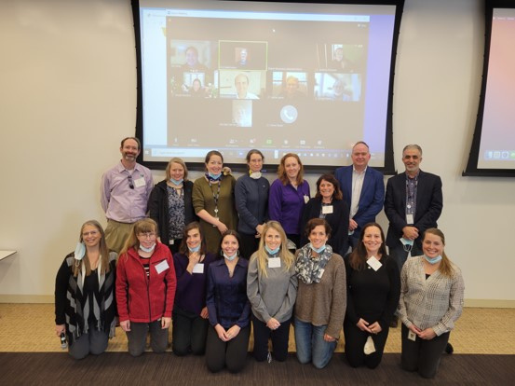
Planning Workshop in 2021 at the Broad
Founded in 2021
Aim to address barriers to performing genetic health studies on animal populations under the care of AZA-accredited zoos
Collaborative Research Initiative
Based at Zoo New England in partnership with the Broad Institute of MIT and Harvard and representatives from various AZA facilities and human medicine

Slide 5
COLLABORATORS
Eric Baitchman, Zoo New England
Alexander Brick, Broad Institute of MIT & Harvard
Marietta Danforth, Great Ape Heart Project at Detroit Zoo
Gina Ferrie, Disney’s Animal Kingdom
Robert Fleischer, Smithsonian National Zoo and Conservation Biology Institute
Michael Garner, Northwest ZooPath
Diane Genereux, Broad Institute of MIT & Harvard
Rachel Johnston, Zoo New England; Broad Institute of MIT & Harvard
Elinor Karlsson, Broad Institute of MIT & Harvard; University of Massachusetts Medical School
Klaus-Peter Koepfli, Smithsonian-Mason School of Conservation
Kerstin Lindblad-Toh, Broad Institute of MIT and Harvard; Uppsala University
John Linehan, Zoo New England
Leslie Lyons, University of Missouri
Tomas Marques-Bonet, Institut de Biologia Evolutiva
Kate Megquier, Broad Institute of MIT & Harvard
Sarah Morton, Boston Children’s Hospital; Broad Institute of MIT & Harvard; Harvard Medical School
Hayley Murphy, Detroit Zoo
Daniel Neafsey, Harvard T.H. Chan School of Public Health; Broad Institute of MIT & Harvard
Andrea Putnam, San Diego Zoo Wildlife Alliance
Oliver Ryder, San Diego Zoo Wildlife Alliance
Christine Seidman, Harvard Medical School; Broad Institute of MIT & Harvard
Cynthia Steiner, San Diego Zoo Wildlife Alliance
John Skyes, Bronx Zoo
Siv Tang, Zoo New England
Karen Terio, University of Illinois College of Veterinary Medicine
Kathy Traylor-Holzer, IUCN SSC Conservation Planning Specialist Group (CPSG)
Michelle White, Broad Institute of MIT & Harvard
Aryn Wilder, San Diego Zoo Wildlife Alliance

Slide 6
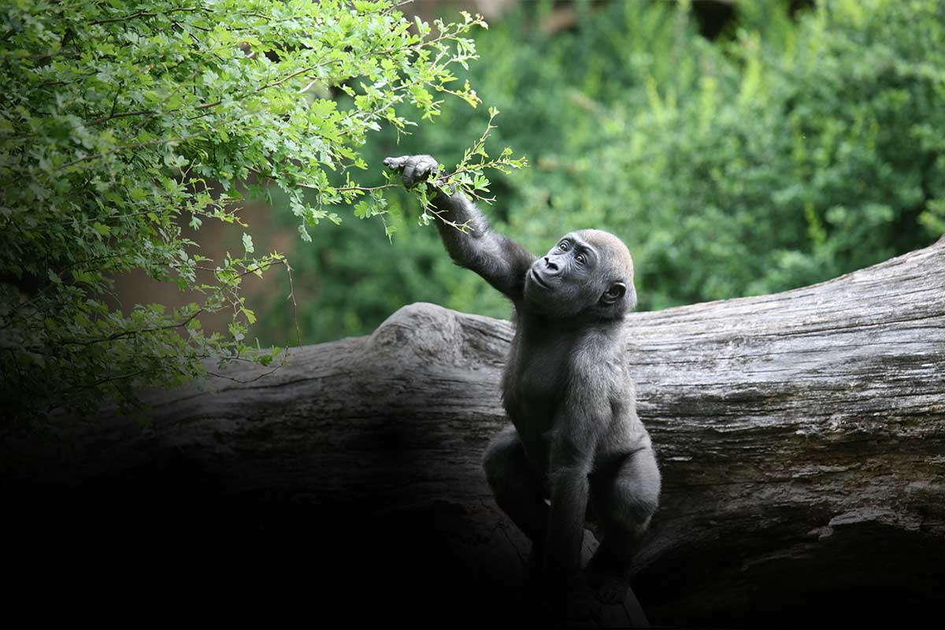
THE MISSION OF THE CENTER FOR ZOONOMICS IS TO INTEGRATE MEDICAL AND CONSERVATION GENOMICS TO IMPROVE HUMAN, ANIMAL, AND ECOSYSTEM HEALTH.

Slide 7
THE MISSION OF THE CENTER FOR ZOONOMICS IS TO INTEGRATE MEDICAL AND CONSERVATION GENOMICS TO IMPROVE HUMAN, ANIMAL, AND ECOSYSTEM HEALTH.
Conservation and health genetics: Identify and tackle the recurrent barriers that stymie conservation and animal health genetics research of zoo animal populations

Slide 8
THE MISSION OF THE CENTER FOR ZOONOMICS IS TO INTEGRATE MEDICAL AND CONSERVATION GENOMICS TO IMPROVE HUMAN, ANIMAL, AND ECOSYSTEM HEALTH.
Conservation and health genetics: Identify and tackle the recurrent barriers that stymie conservation and animal health genetics research of zoo animal populations
Health Genetics Expertise: Support communication and collaboration between the genetics and zoo communities

Slide 9
THE MISSION OF THE CENTER FOR ZOONOMICS IS TO INTEGRATE MEDICAL AND CONSERVATION GENOMICS TO IMPROVE HUMAN, ANIMAL, AND ECOSYSTEM HEALTH.
Conservation and health genetics: Identify and tackle the recurrent barriers that stymie conservation and animal health genetics research of zoo animal populations
Health Genetics Expertise: Support communication and collaboration between the genetics and zoo communities
Engagement in the AZA Community: Support zoos with the infrastructure needed to enhance their involvement in health and genomics research that promotes healthy animal populations and ecosystems, while driving forward AZA’s vision of advancing animal wellbeing, public engagement, and the conservation of wildlife and wild places

Slide 10
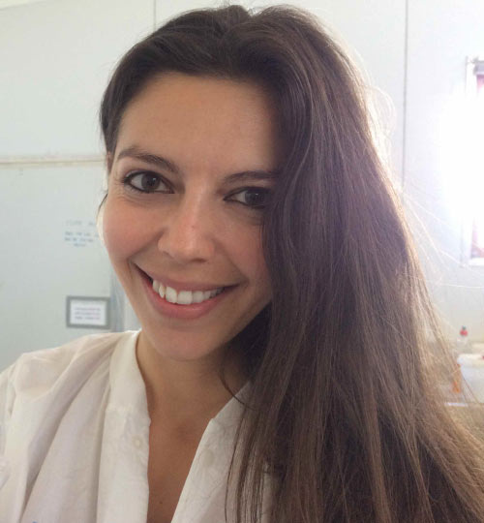
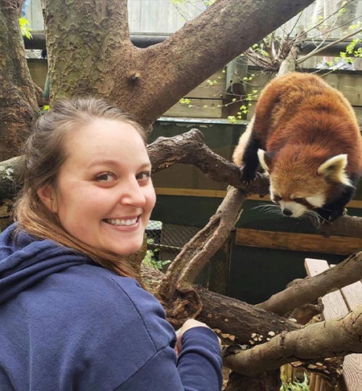
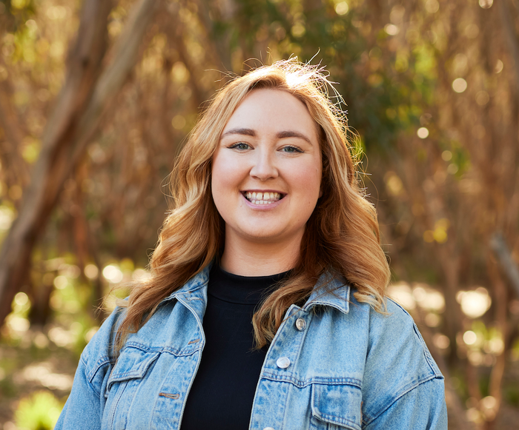
CENTER FOR ZOONOMICS TEAM
Dr. Eric Baitchman, DVM, DAZCM
Co-Founder and Veterinary Advisor
Vice President of Animal Health and Conservation Zoo New England
Dr. Elinor Karlsson, PhD
Co-Founder and Genomics Advisor
Director of Vertebrate Genomics , Broad Institute of MIT & Harvard
UMass Chan Medical School
Dr. Rachel Johnston, PhD
Conservation Genomics Scientist
Director of Conservation Genomics Zoo New England
Danica Wolfe
Project Coordinator
Zoo New England
Dr. Tahlia Perry, PhD
Postdoctoral Researcher
Zoo New England

Slide 11


















Slide 12

GROUP INTRODUCTIONS
Name
Role
Institution

Slide 13
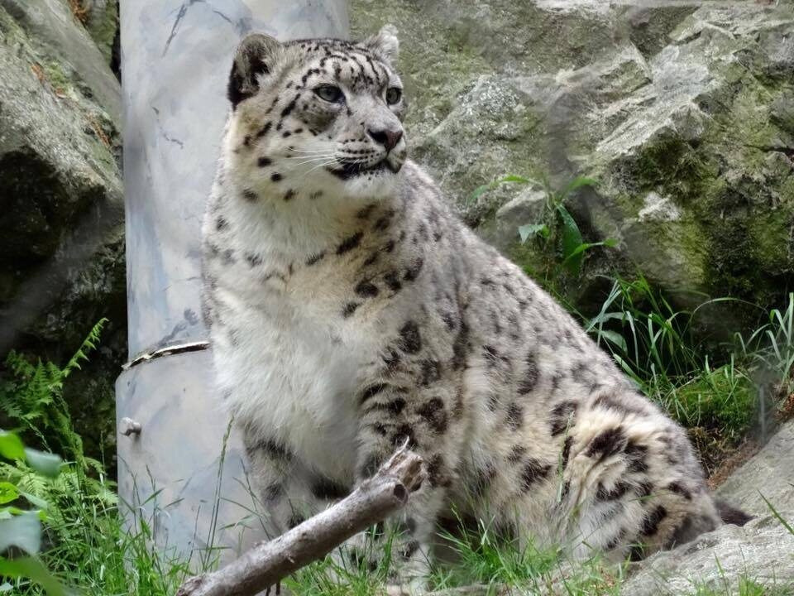

GROUP STRUCTURE AND HOUSEKEEPING
ACTIVE PARTICIPATION
Everyone should feel comfortable sharing their ideas and perspectives

Slide 14

GROUP STRUCTURE AND HOUSEKEEPING
ACTIVE PARTICIPATION
Everyone should feel comfortable sharing their ideas and perspectives
RESPECTFUL DIALOGUE
Allow time and space for each participant to fully express their thoughts

Slide 15

GROUP STRUCTURE AND HOUSEKEEPING
ACTIVE PARTICIPATION
Everyone should feel comfortable sharing their ideas and perspectives
RESPECTFUL DIALOGUE
Allow time and space for each participant to fully express their thoughts
MEETING NOTES
A designated notetaker will capture key points during each meeting and share them with Danica, who will then distribute to the group within one week

Slide 16

GROUP STRUCTURE AND HOUSEKEEPING
ACTIVE PARTICIPATION
Everyone should feel comfortable sharing their ideas and perspectives
RESPECTFUL DIALOGUE
Allow time and space for each participant to fully express their thoughts
MEETING NOTES
A designated notetaker will capture key points during each meeting and share them with Danica, who will then distribute to the group within one week
EMBRACE DISAGREEMENT
It’s okay to disagree about ideas or processes--let’s collaborate and consider all viewpoints

Slide 17
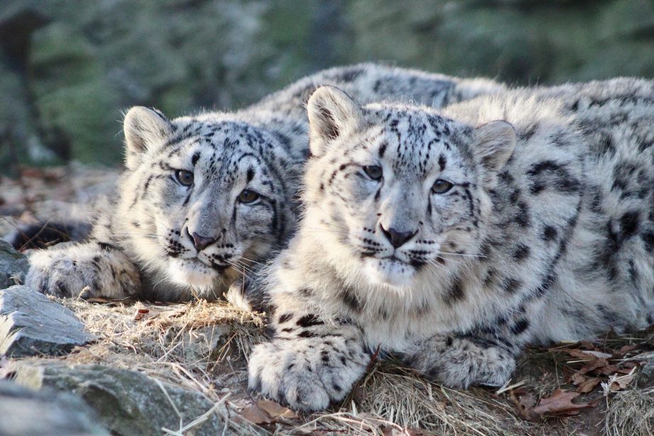
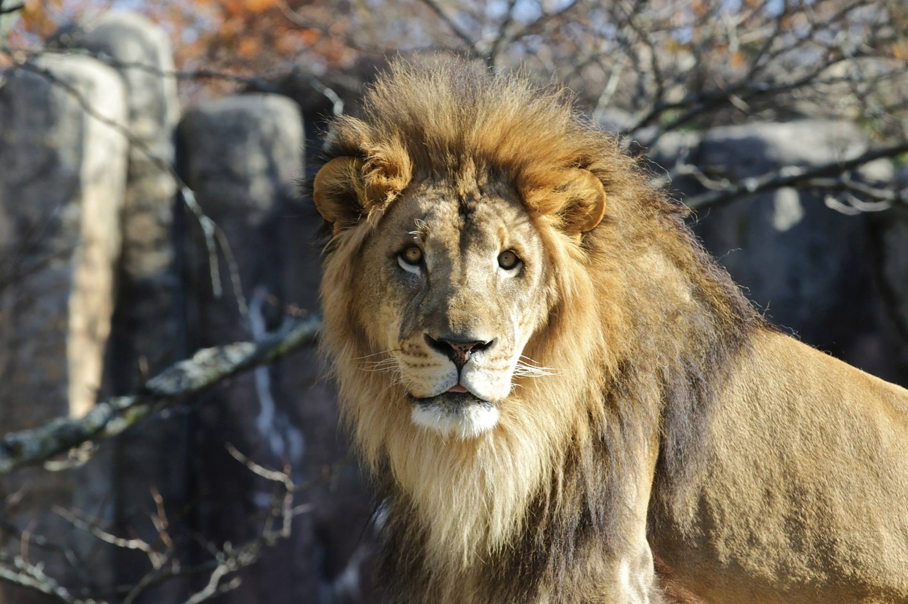


NEXT STEPS
Agenda for upcoming meetings will be emailed out with each meeting invite
Meetings will be held once a month (virtually)
We will be adjusting the plan to whole group meetings rather than subcommittees (for now)
Proposed next date is Tuesday, May 27th,
12-2pm EST
zoonomics@zoonewengland.org
zoonomics.org

